Slide 1

WEB SCRAPING

Slide 2
WEB SCRAPING & EXPLORATORY DATA ANALYSIS USING PYTHON

Slide 3
Web Scraping and Exploratory Data Analysis of “Flipkart Mobile Phones”

Slide 4
About me
My Name is Karava . Anoosha
I completed my Graduation Bachelor of computer Science
I have a passion for working for data-driven, innovative companies.

Slide 5
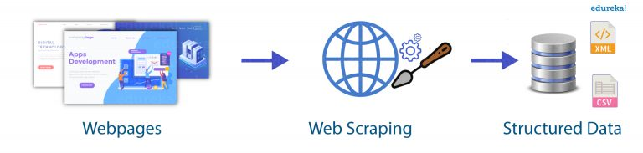
WEBSCRAPING
Extracting the data of mobiles from flipkart shopping website.
Exploratory data analysis.
Data cleaning.
Converting dataframe to 'csv’ file.
Data visualization

Slide 6
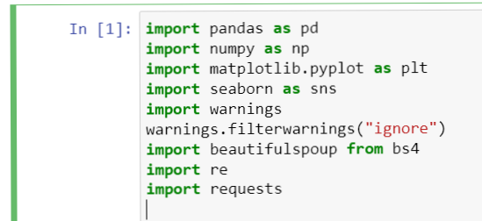
Web scraping using python
Python libraries used for web scraping ,EDA & visualization:-
1.Beautifulsoup
2.Pandas
3.Matplotlib
4.Seaborn
5.regex
Scrap the data of mobiles from flipkartwebsite
Importing libraries:-

Slide 7
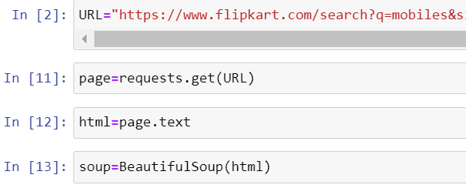
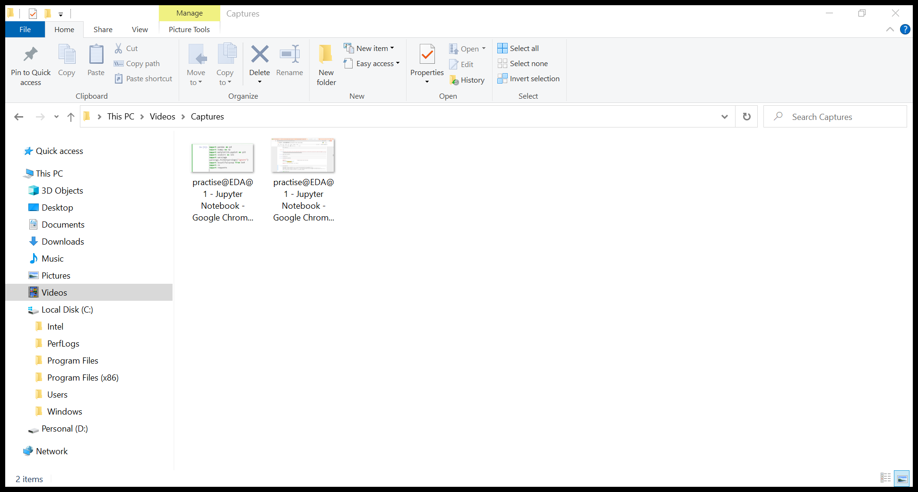
FINDING URLAND GETTING DATA BY BELOW CODES

Slide 8
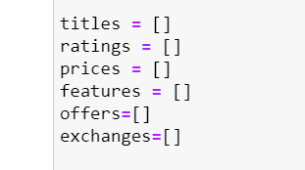
Creating Empty lists to store the data in structured form

Slide 9
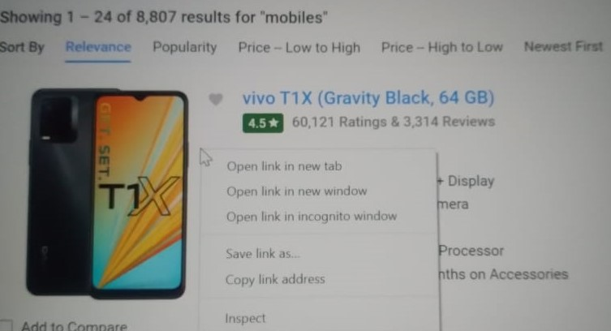
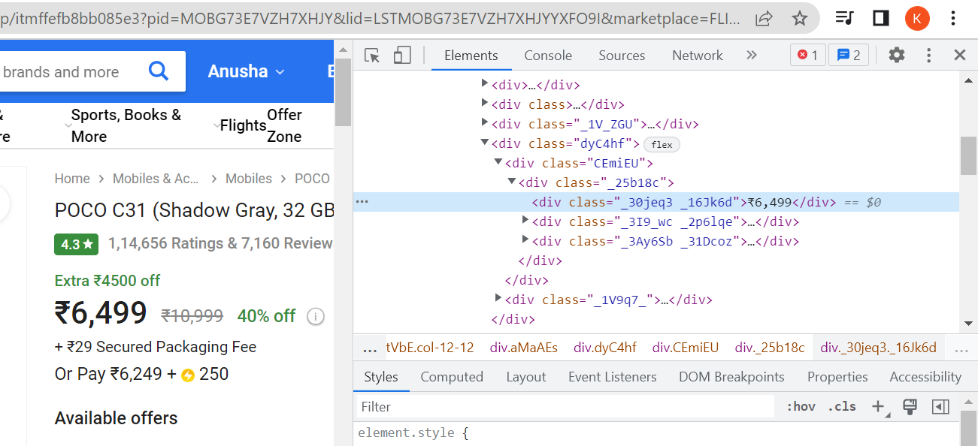
Inspecting page
Under which tag the data was stored

Slide 10
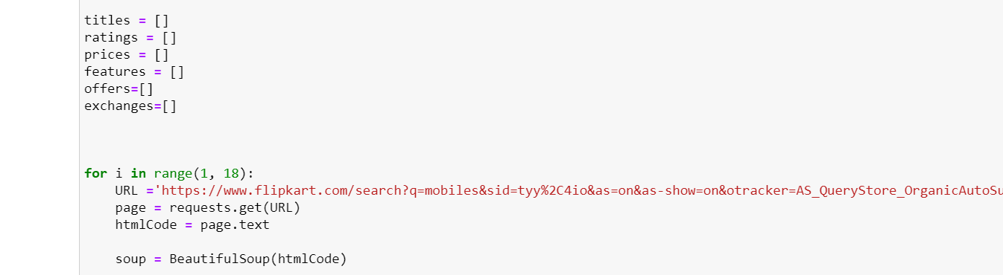
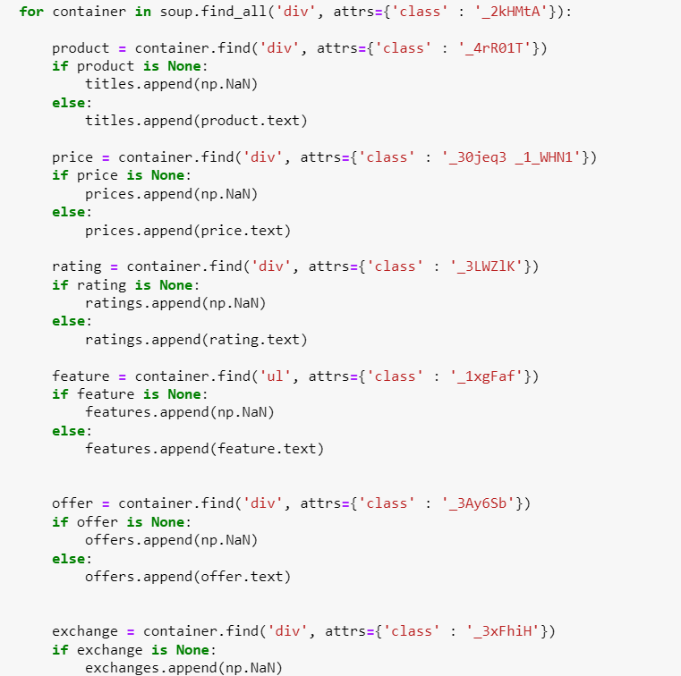
Extract the data by running below code

Slide 11
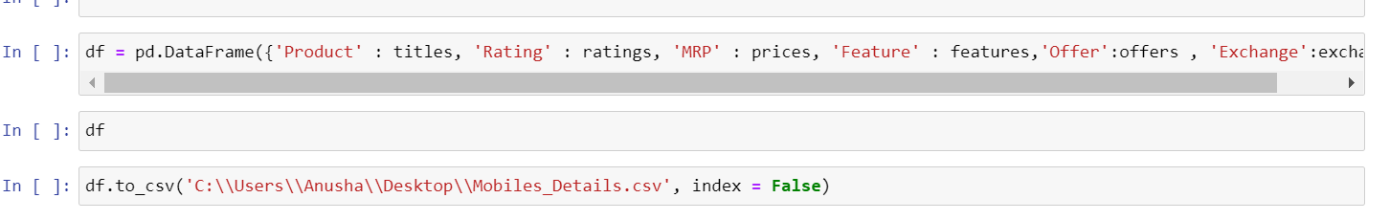
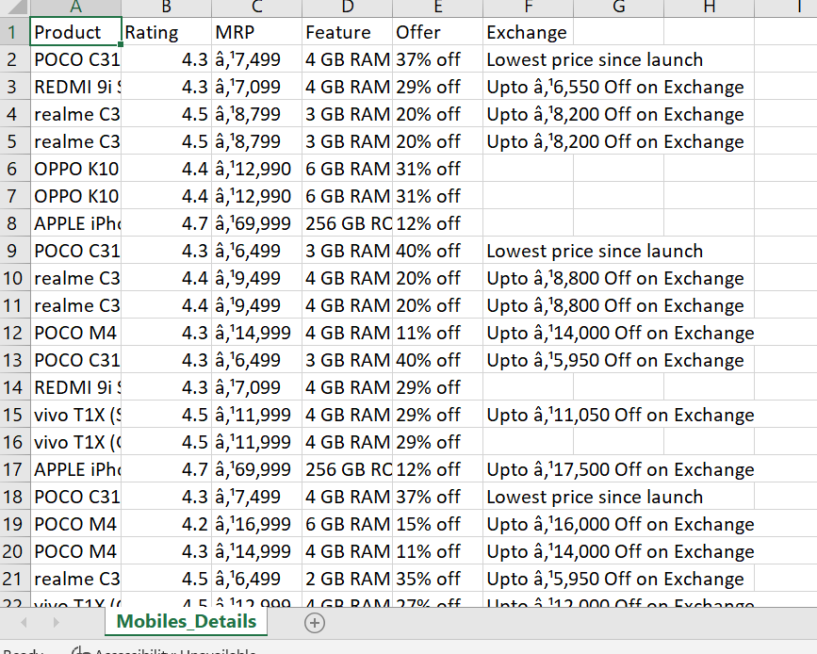
Creating Data Frame& Converting Data Frame to .CSV file

Slide 12
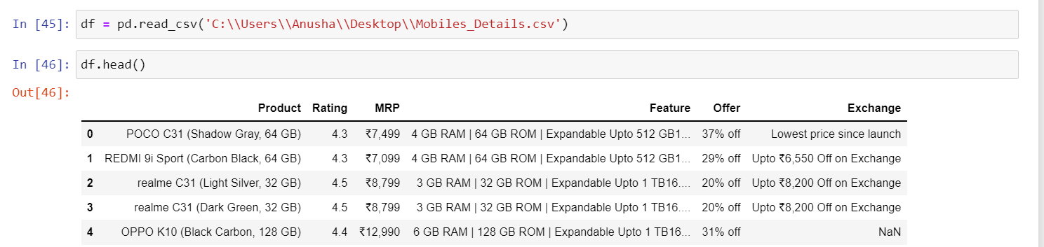
Importing the csv file to notebook :-

Slide 13
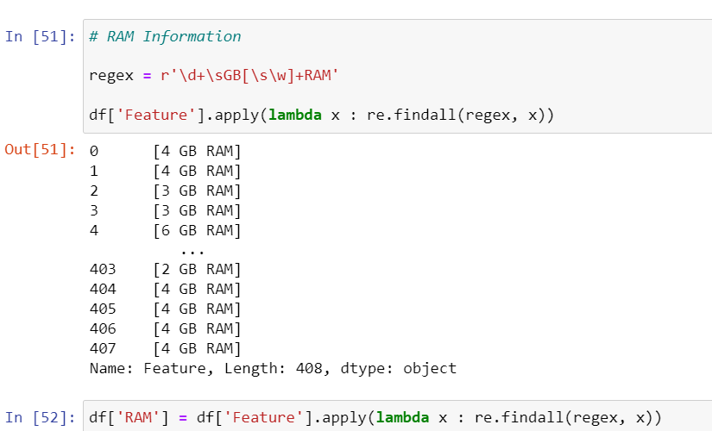
Adding columns to DataFrame using regex:-
By differentiating the brand and specifications(RAM, Brand) using regex

Slide 14
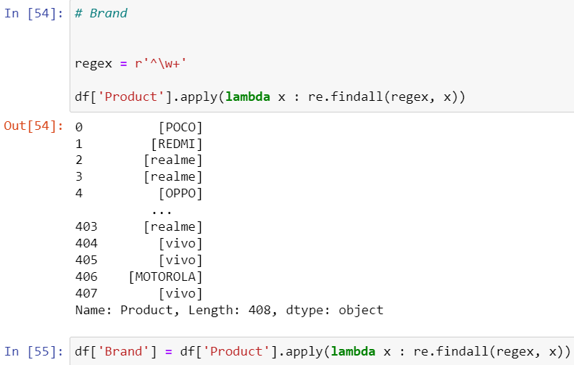

Slide 15
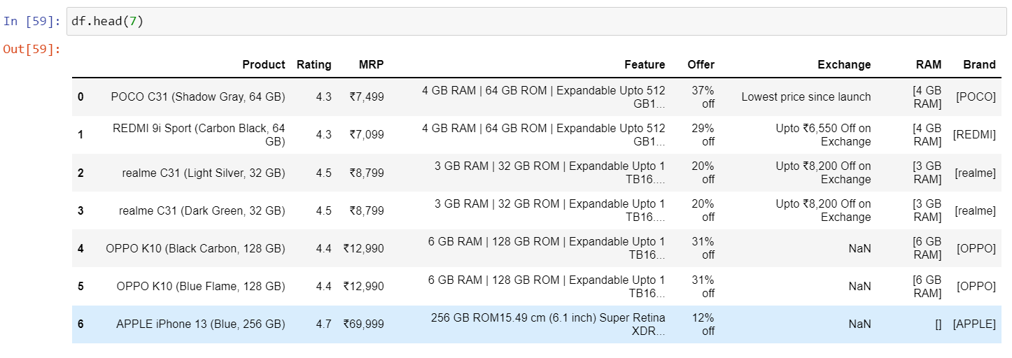

Slide 16
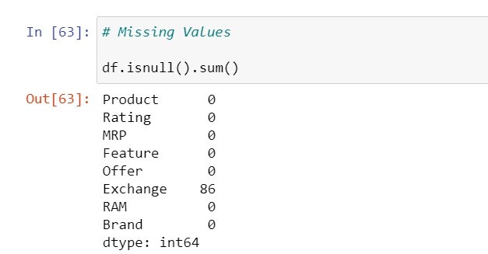
Identifying missing values in Data Frame:-

Slide 17
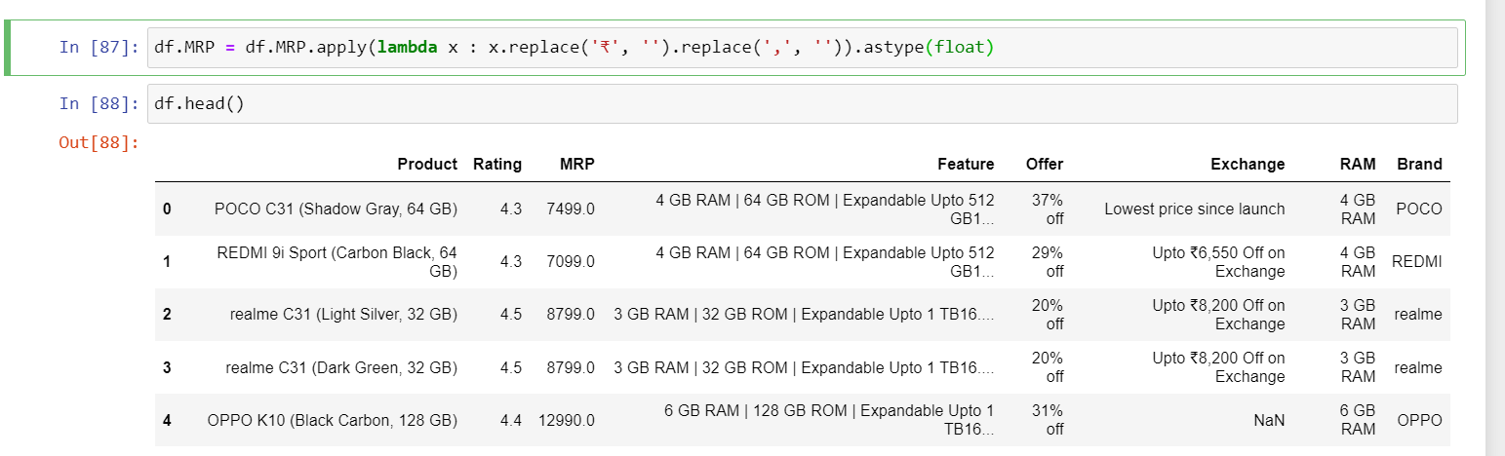
Cleaning the Data:~
Removing ",and rupee symbol"

Slide 18
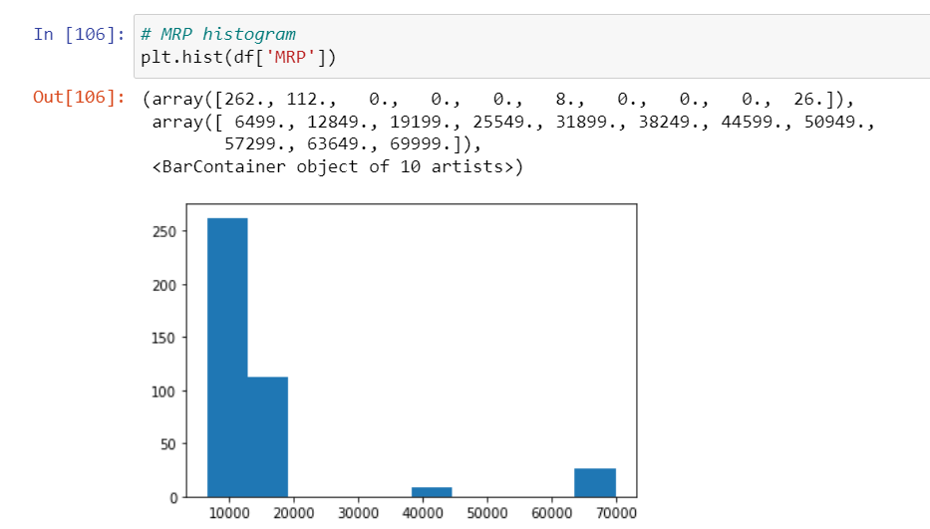
Data Visualization by Plots:~
1.Histogram for MRP:

Slide 19
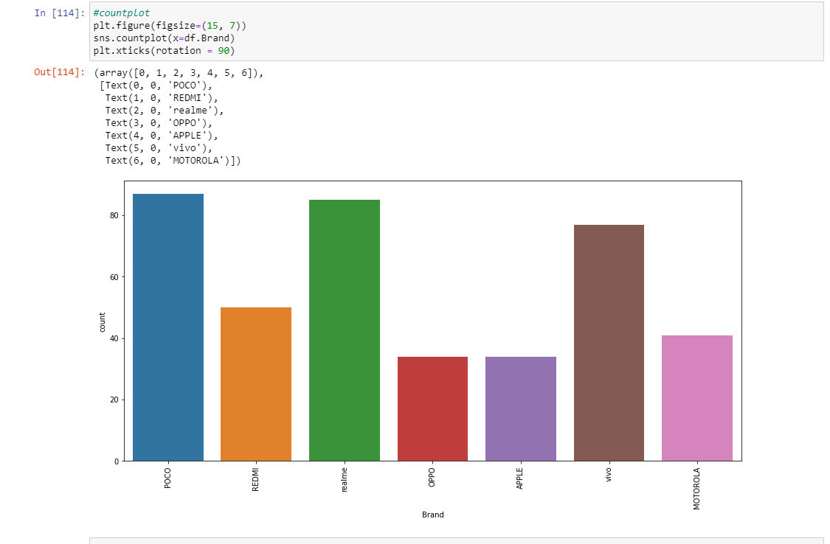
2.Count Plot:~

Slide 20
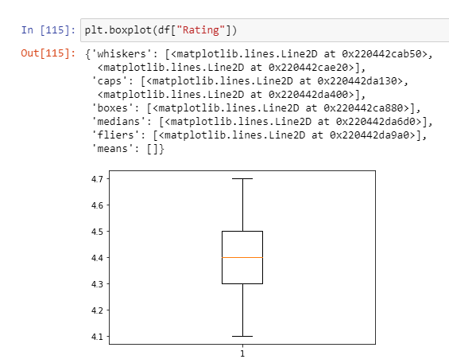
3.Box Plot

Slide 21
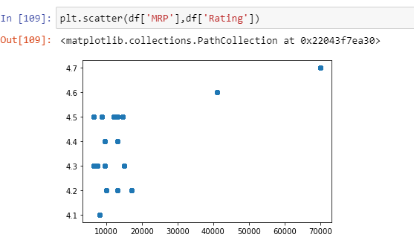
4.Scatter Plot:~

Slide 22
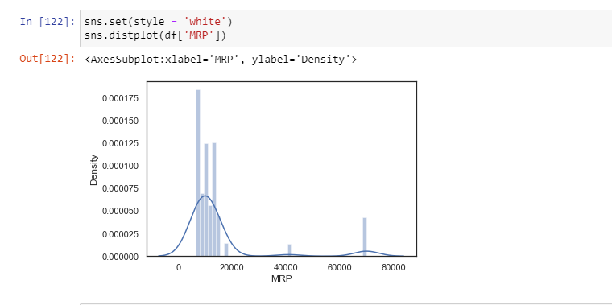
5.Displot:~

Slide 23
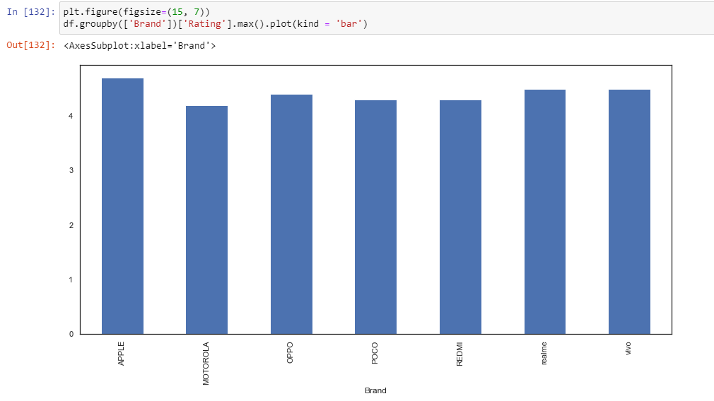
6.Bar Graph

Slide 24
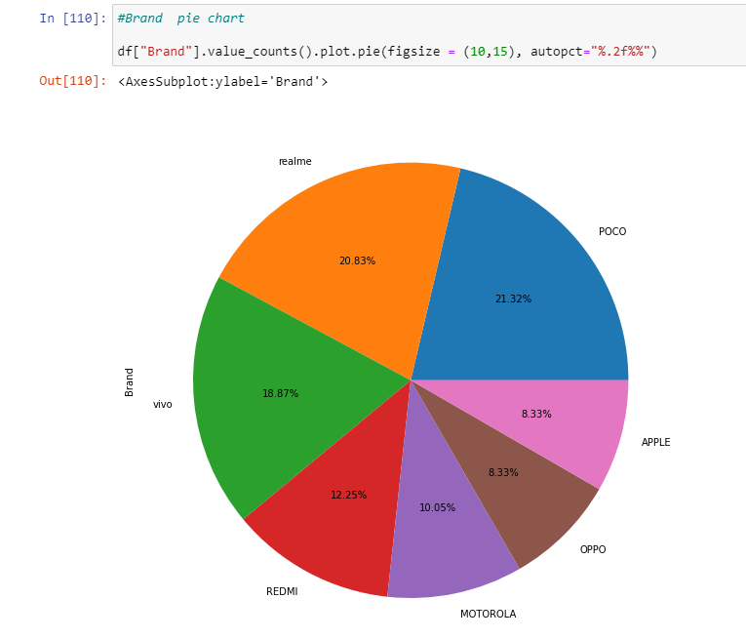
7.Pie Chart

Slide 25
CONCLUSION
we have plotted the tips dataset with the help of the four different plotting modules of Python namely Matplotlib, Seaborn, Bokeh, and Plotly.
Each module showed the plot in its own unique way and each one has its own set of features like Matplotlib provides more flexibility but at the cost of writing more code whereas Seaborn being a high-level language provides allows one to achieve the same goal with a small amount of code.
Each module can be used depending on the task we want to do.

Slide 26

THANK YOU

